Slide 1


Chowgacha-Jhenaidah model is the best example of community participation
Dr. Md.Emdadul Haque
Ex Senior Consultant (Obs&Gyne)
Jhenidah Sadar Hospital

Slide 2
A Hospital with a Vision …
Maximum utilization of Govt.
resources with
honesty and sincerity.
Integrated approach of
Administration, Community
Leaders .
Providing Effective services
through improved
management system.

Slide 3





CHOWGACHA UHC-Through the Ages
Old UHC
Old UHC
31-bedded UHC
50-bedded UHC

Slide 4
Background History of Chowgacha Health Complex Model, Jessore
Basically started in 1995.
Effectively started in Feb. 1996.
From January 1995 to 1997 JICA helped by Frontline MCH Program by giving technical and logistic supports.
Since 1998 DGHS & UNICEF have continued the support.
<4 Special activities>
ANC-Corner
Basic EOC service
Under 5 corner for under 5 children
Monthly birth and death record

Slide 5
Background History Contd.
November 2000 started Comprehensive EOC program
April 2007-Demand Side Financing (DSF) program started.
Hospital declared as model health complex on 20 June 2008 and upgraded to 50 bedded hospital by MOH&FW.
“Chowgacha health complex Model is replicable through out the country” Declared by Dr. Margaret Chan, D.G. WHO on 8th March 2010.
Piloting to replication C-J model launched in 10 district hospital by HEU of MOH&FW in 2016.
Prime minister's office issues order to replicate the model throughout the country in2017.
DGHS started to replicate C-J model in all upazilla UHC & DH in june 2018.

Slide 6


Blood donation program stared in 16 December, 1996 in Chowgacha UHC
A seminar on ‘Importance of birth & death registration and prevention of early marriage’ at Chowgacha Degree College in June, 1997. DC Jessore was the chief guest.

Slide 7


Citizen Charter

Slide 8

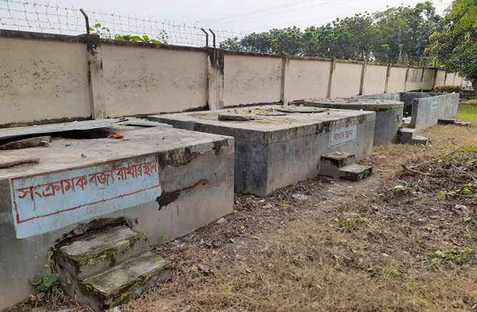
Innovations of Chowgacha Health Complex
Cycle stand near the entrance
Developed Waste Management System

Slide 9
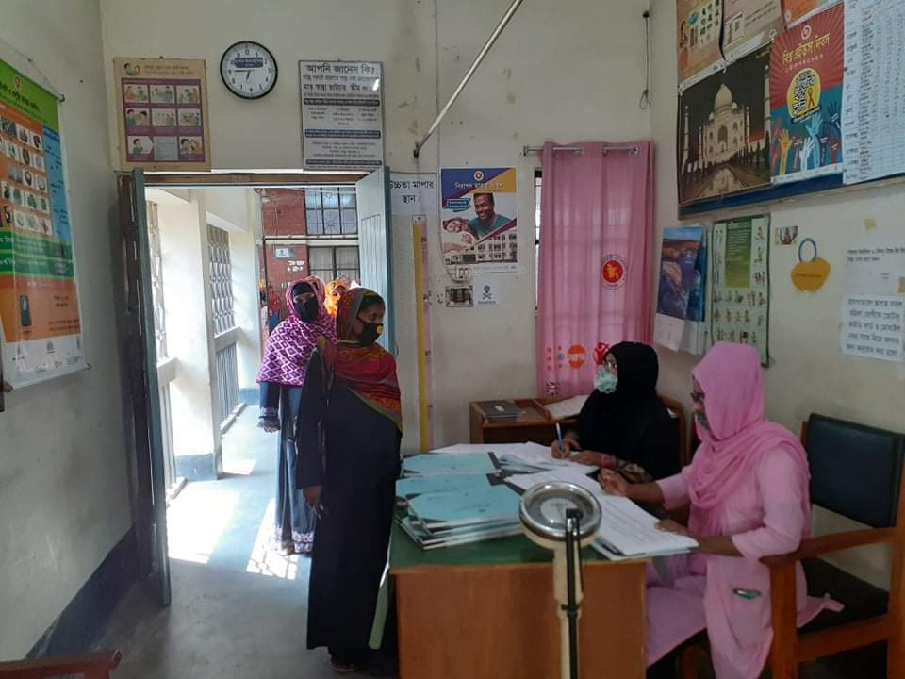
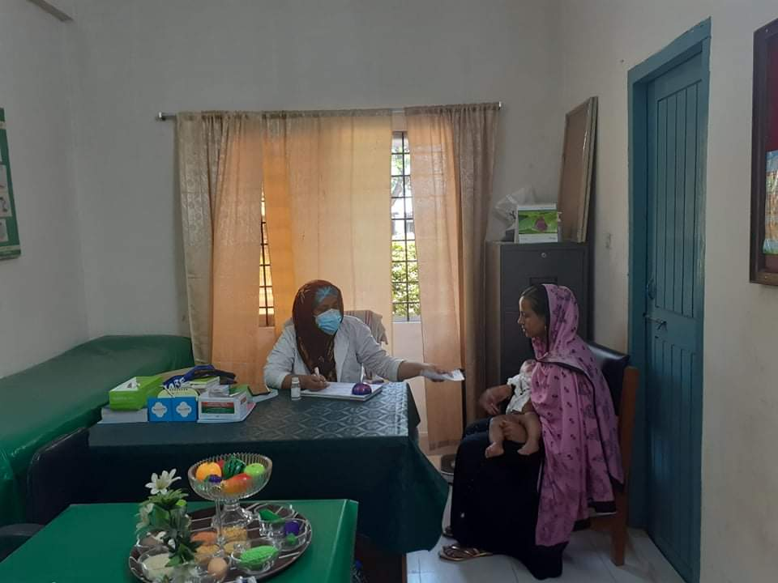
Daily Activities
ANC Corner
IMCI corner

Slide 10
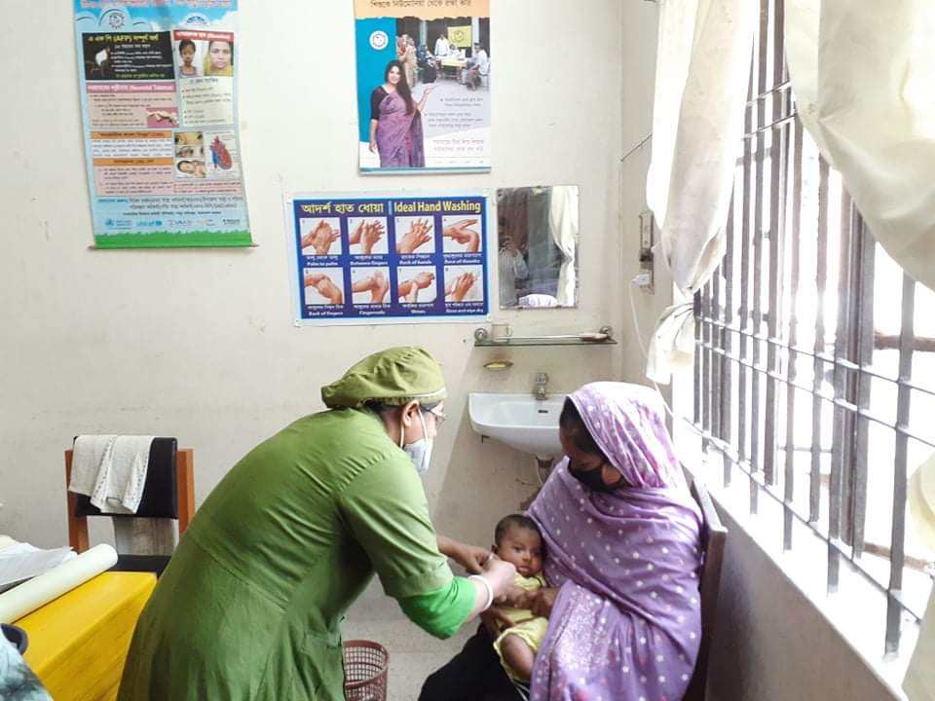
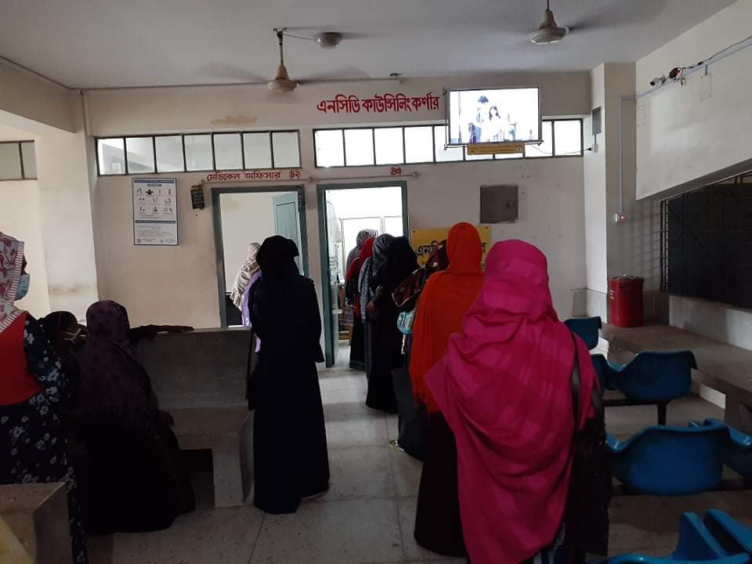
Daily Activities
Breast feeding & EPI Corner
NCD Corner

Slide 11
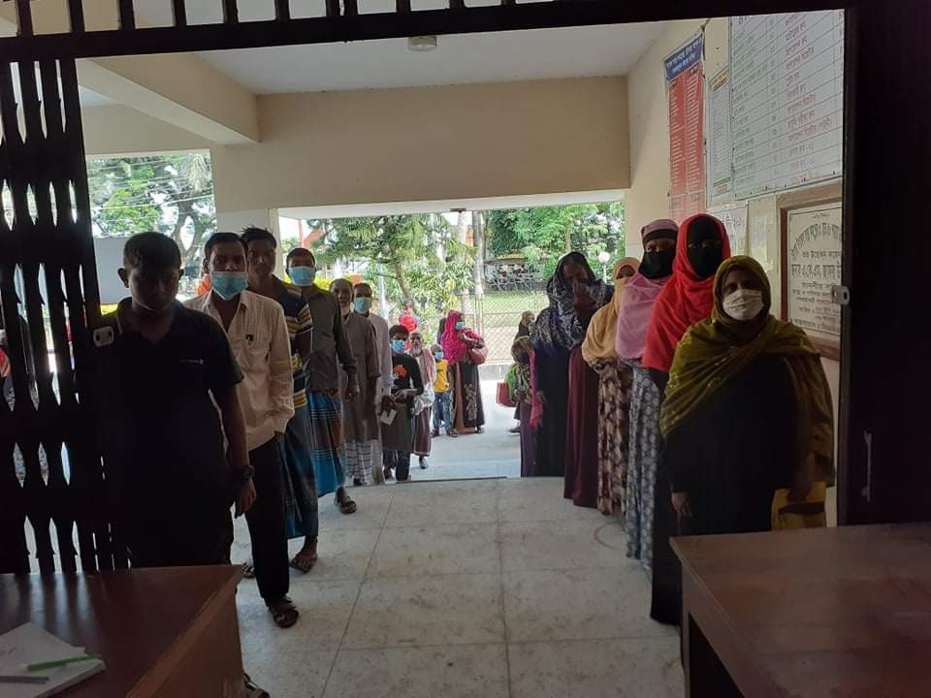
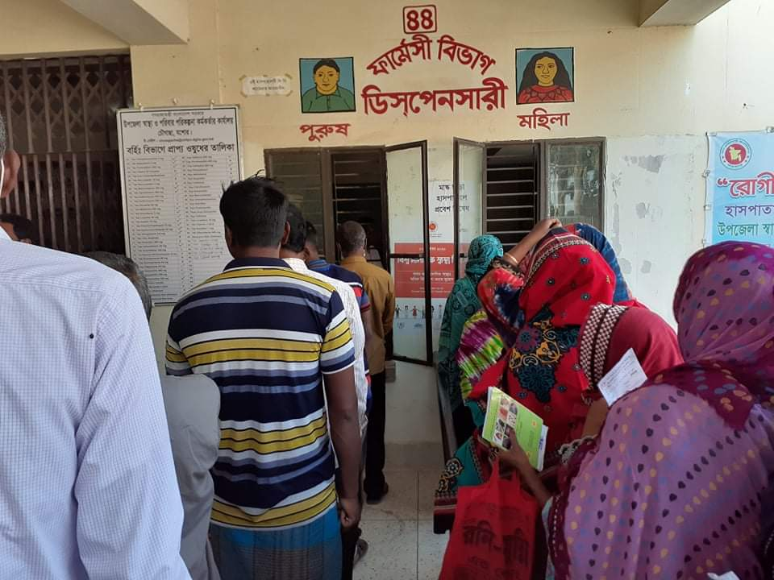
Daily Activities
Separation of male and female patients in Outdoor
Dispensary with separated male and female

Slide 12


Daily Activities
Labour Ward with 41=(11+30) beds
Rest room for pregnant mothers

Slide 13
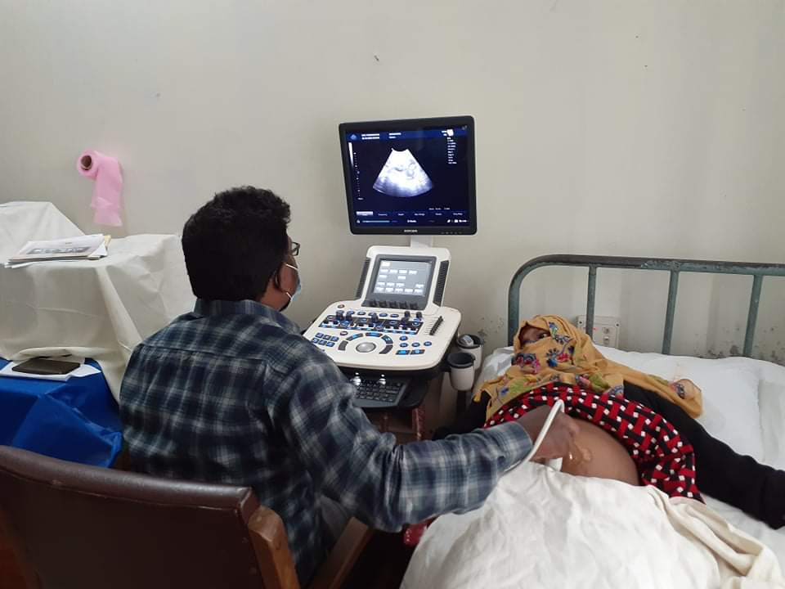
Community Participation
Ultrasonography machine donated by the Upazila Porishod

Slide 14




Community Participation

Slide 15
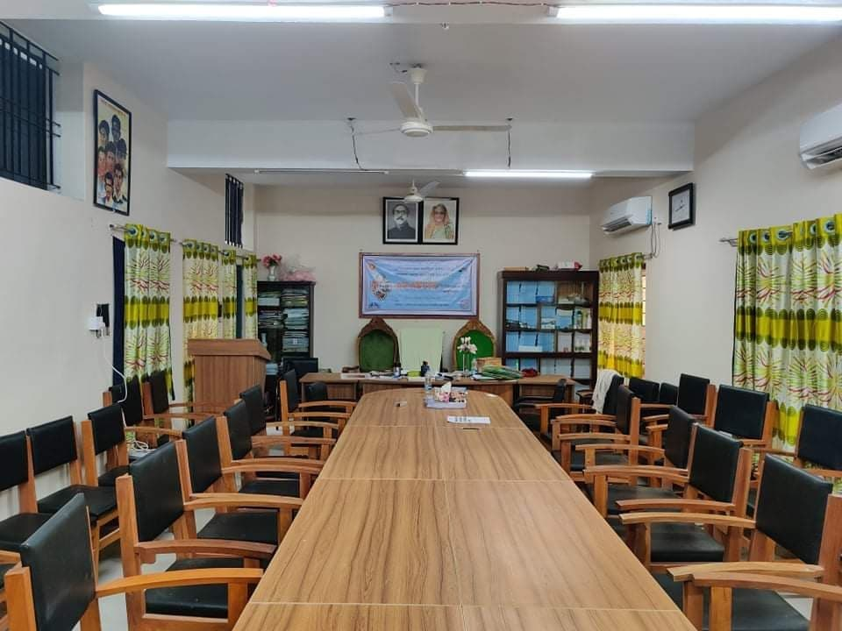
Newly Decorated Conference Room

Slide 16


Visit by Dignitaries – UHC Chowgacha
Honorable Health Minister Prof Dr. Ruhul Haque
MP with WHO Representative handing over
money and gift of voucher scheme of DSF
Secretary of MOHFW A.K.M. Zaforullah Khan
declared “Chowgacha UHC model” in DSF
voucher distribution ceremony on 20 June-2008

Slide 17

Upazila Health Complex
CHOWGACHA , JESSORE.
EOC Activities : 1997- 2011 (Hospital Delivery )

Slide 18

Upazila Health Complex
CHOWGACHA , JESSORE.
EOC Activities : 2000 - 2011 (Caesarian Section)

Slide 19
Upazilla Health Complex
CHOWGACHA , JESSORE.
COMMUNITY SUPPORTED MANPOWER
TOTAL :46
  Volunteers :26
  Cleaners & guards :16
  Others :04
  The remunerations come from
  Outsourcing :25
  Service provider :21
  The amount of remuneration ranging from 200/= To 8000/=tk. Per month depending upon the style of work, which costs a total of nearly 90,ooo/=Tk per month.

Slide 20






Slide 21
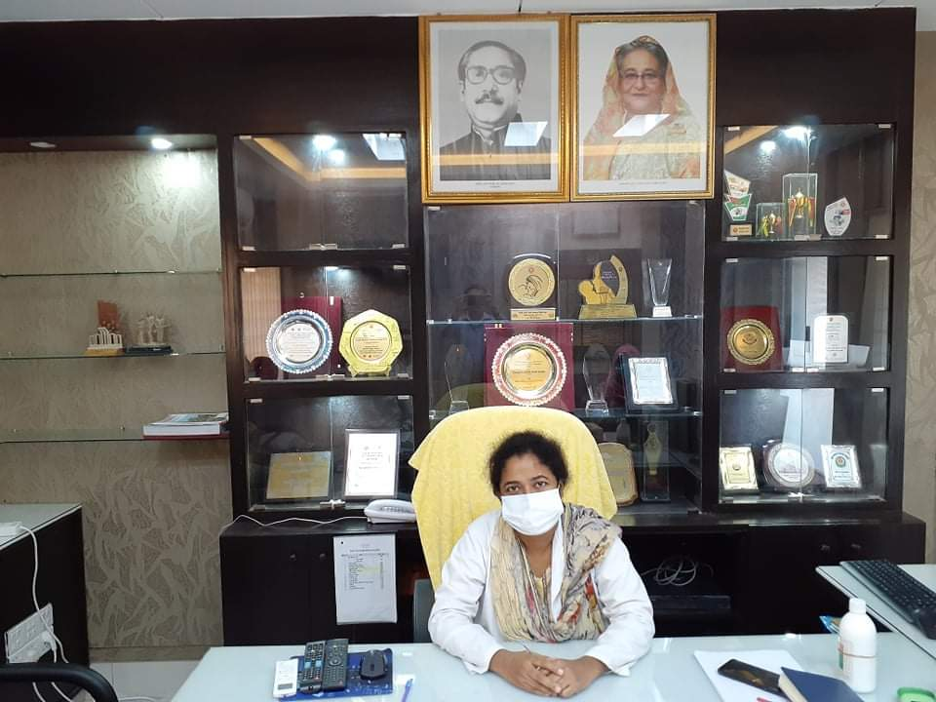
ACHIEVEMENTS of CHOWGACHA HEALTH COMPLEX
In 2008, Chowgacha Health Complex declared as the Model Upazilla Health Complex
  Chowgacha UHC achieved MDG target in 2009
  Chowgacha UHC became the Best EOC center with 98.4% delivery rate in 2011
  Chowgacha Health complex is awarded for best performance in EOC form 2005 to 2014
  Achieve Health Ministers Award for its best performances in 2017 and 2018
  The UHC starts upgrade to 100 bedded hospital
  The UHC model is being replicated throughout the country by DGHS, MOH & FW since 2016 by the order of Prime Ministers office

Slide 22

100 kh¨v wewkó m`i nvmcvZvj, wSbvB`n

Slide 23
Challenges of the hospital in 2012
Insecure hospital environment.
Performance of all activities was very low.
Very limited support staff.
3 doctors including RMO was suspended.
Non-gov. staff. demanding money from the patients.
Waste management system was poor.
Monitoring meeting was not performed regularly

Slide 24
Characteristics of Jhenaidah Sadar Hospital Model-1
Successful leadership in health management.
Personal and group skills in health care.
Community engaged health management.
Optimum use of government resources.
Effective relation with local administration and with other government organizations.
Improvement of security by community engagement.
Improved maternal health care activities.
Improved child health care activities.
Ensuring corner-based health care.

Slide 25
Characteristics of Jhenaidah Sadar Hospital Model-2
Woman and Baby Friendly Hospital.
Birth and death recording, progress assessment and develop accountability by collecting information on all health indicators.
Improving healthcare by unit management.
Health awareness by health education.
Cleanliness (Waste management) and beautification of the facility and premises.
Provision of safe blood transfusion for emergency needs
Zero tolerance against corruption.
Implementation of the 5S KAIZEN-TQM for the improvement of health quality.

Slide 26

Sadar Hospital, Jhenaidah
Bed Occupancy Rate from 1998 to 2019

Slide 27


Emergency + Out Door & Indoor Service 1998 to 2019
Emergency + Outdoor visit, Indoor (admission)

Slide 28
Operation Service (Major) 2011 to 2019
Sadar Hosital, Jhenaidah

Slide 29

Sadar Hospital, Jhenaidah
Admitted Under 5 children in indoor from 2014 to 2019

Slide 30
Total ANC and Delivery in Jhenaidah District Hospital 2011-2019

Slide 31
Comparative Data of Delivery of best performing EOC center of Khulna Division in 2011,2017,2019
 |  | 2011 |  | 2017 |  | 2019
SL No | Name of institute | C. Section | Total | C. Section | Total | C. Section | Total
01 | Khulna Meidcal College | 1356 | 3013 | 1228 | 2683 | 1828 | *4362
02 | Jashore Meidcal College | 1498 | 2852 | 1778 | 2967 | 1503 | 3078
03 | Kustia Meidcal College | 915 | 2677 | 1030 | 2781 | 1616 | 3674
04 | 100 bed,Jhenaidah Sadar Hoapitals | 430 | 2375 | 1143 | *2997 | 1019 | 2753
05 | Chowgacha UHC | 1007 | *4413 | 759 | 2922 | 854 | 2957

Slide 32
Comparative data of revenue income (in Taka) from 2015 to 2019
Sadar Hospital, Jhenaidah

Slide 33
Community Support System in Sadar Hospital
Staff : 53
  Cleaner: 20
  Aya /Word boy: 21
  Security guard: 6
  Volunteer: 3
  Trolley man: 3
Generator.
Intercom.
Biochemical analyzer.
Reformation of medicine, surgery, pediatric word.
Boundary wall repair.
Dining space for patients.
Donors:
MP.
Mayor.
Zahedee Foundation.
Doctors.
Other donors
Retd. Secretary .

Slide 34


Visit to Shatkhira District Hospital and Introduction of TQM activities
A team of Jhenaidah sadar hospital visited to Shatkhira sadar hospital in 2014
A meeting was held in Shatkhira sadar conference room

Slide 35


5S KAIZEN-TQM Program Started in Jhenaidah Sadar Hospital in 2014
TQM program started in Jhenaidah Sadar Hospital
A meeting of QIC was held in Jhenaidah Sadar Hospital Conference room

Slide 36




Changes in EOC Ward
Before
After
Before
After

Slide 37








Changes in Surgery & Pediatric Word

Slide 38




Waste Management & Campus Protection
Before
After
Before
After

Slide 39




Use of direction sign, labeling of rooms, clean latrine and waste segregation
Use of direction sign
Labeling of rooms
waist segregation
Clean latrine

Slide 40




Use of color code, alignment of picture & continuous big cleaning day
Color code
Color code
Alignment of pictures

Slide 41


Innovative activities of Jhenaidah Sadar Hospital - 1
Creation of awareness towards Health Education for the patients and their attendances.
Motivation of the community, the teachers, reporters, social workers, cultural activists and donors of the hospital .

Slide 42




Innovative activities community supported manpower - 2
Trolley man
Cleaner
Guard
Nursing aid

Slide 43




Innovative activities of Jhenaidah Sadar Hospital - 3
Repaired boundary wall
Campus beautification
Cycle stand
Recovery of hospital land

Slide 44




Innovative activities of Jhenaidah Sadar Hospital - 4
Digitalization of patient profile
Organized pharmacy
Improved conference room
Visitor Restriction

Slide 45


Innovative activities of Jhenaidah Sadar Hospital - 5
Reception room provided by community support
ECG facility in enemrgency department

Slide 46



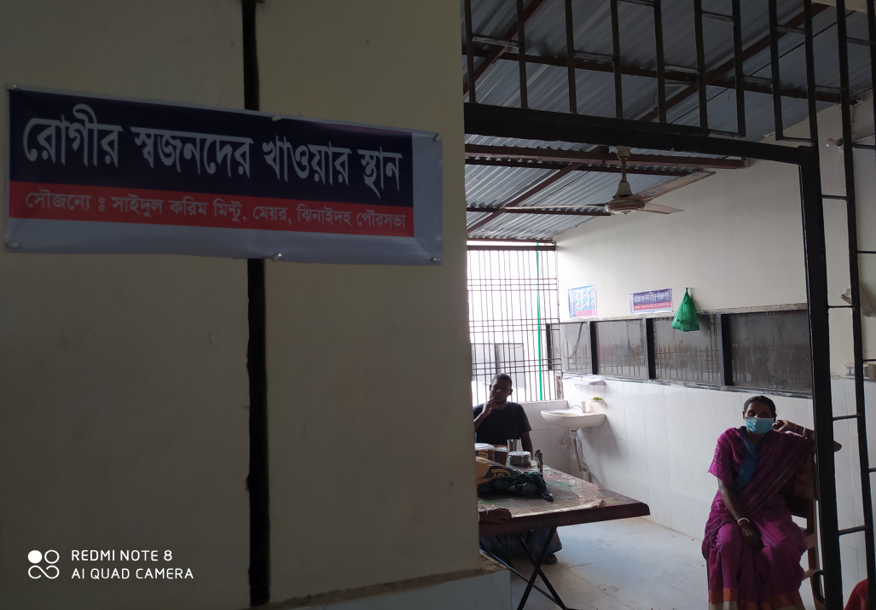
Innovative activities of Jhenaidah Sadar Hospital - 6
Intercom system by community sup.
Generator by community sup.
Dining facility by community sup.
Extension of hospital mosque

Slide 47




Involvement of MP, District Administrator & Mayor in Sadar Hospital
Perticipation of Previous MP in beautification
Perticipation of Previous Zilla parishad chairman
A big cleaning day on 17 March
Crowd control by scout

Slide 48




Involvement of district high officials in hospital activities
Blood donation camp by district judge
Hospital visit by DC
Hospital visit by SP
Manobota blood donor group opened by CS

Slide 49




Internal Monitoring System
Meting of health improvement committee
Meting of community support group committee
QIC meeting
Monthly meeting schedule

Slide 50




Improved pediatric word by local initiative

Slide 51
Achievement of the Hospital
1. Active Community Participation in health service is an example in Bangladesh.
2. Improved performance of all services specially Pediatric, obstetric, operation
and outdoor service.
3. Improved Cleanliness and Beautification of Campus.
4.. The hospital is awarded 6 times from 2013 to 2018.
5. Improved Security.
6. Improved Financial Management
7. Replication of C- J Model by DGHS in 20 District hospital & 40 UHC of the country.

Slide 52
Lessons learned
Public health and hospital services and resources are inadequate vis-à-vis the need specially for the poor
This gap can be minimized through local participation.
Effective health service and hospital management require local support and participation.
Health personnel, specially the local health manager should take the role of catalyst
Local support can be attracted through improved services, and visible efforts and morality of the health managers
MOHFW can take initiative to roll out the model and the message
Jhenaidah-Chowgacha team will happy to volunteer

Slide 53

Thank You
আমাদের বাগানের ফুল
Notes:
53

